Slide 1



Home Credit Default Risk
Predicting how likely each applicant
is of repaying a loan?

Slide 2
Agenda
Business problem
Approach
Data / Data wrangling
Exploratory data analysis
Predictive modeling
Conclusion
Future work
01

Slide 3
Many people struggle to get loans due to insufficient or
non-existent credit histories.
This population is often taken advantage by untrustworthy lenders.
Home credit tries to include the unbanked population to support their economic needs.
02

Slide 4
Goal, identify if a new client shows a high risk for loan default.
How can this help?
Reduce Uncertainty
Proportional Disbursement
Risk Reduction
Doesn’t leave business on the table!
03

Slide 5

Uses supervised machine learning to classify one of two categories.
Supervised machine learning is a phenomenon where the AI learns from the data without anyone writing explicit code logic.
Target Labels
0
1
Target label of 0 indicates that there was no difficulty in repaying the loan on time.
Target label of 1 indicates that there was difficulty in repaying the loan on time.
04
Image courtesy : https://www.expertsystem.com/machine-learning-definition/

Slide 6
The data is taken from Kaggle’s competition, publicly available.
application_train.csv
307511 Records, 122 Columns
Imbalanced Target Labels.
Source for training machine Learning models.
Target Labels :
0’s – 282686, 1’s - 24825
application_test.csv
48744 Records, 121 Columns
No Target Labels.
Source for testing the performance of machine Learning models.
Target Labels :
None – need to predict.
05

Slide 7
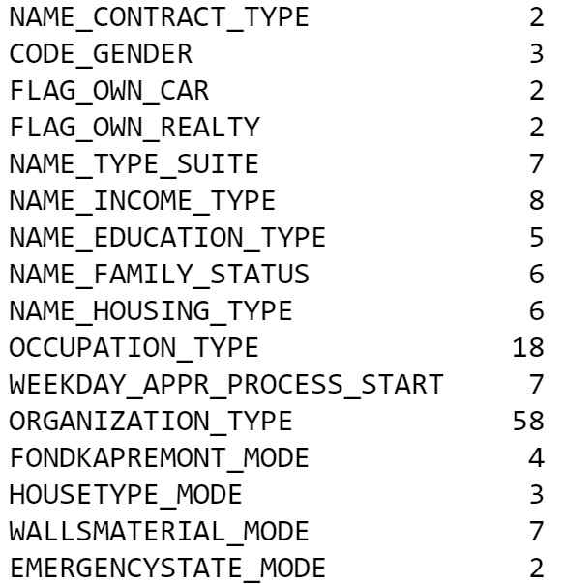
Cleaning the data first involves understanding the columns
There are 122 columns with different data types:
65 floating point numbers.
41 integer numbers – some are numerical categories.
16 Strings – Categories involved.
ORGANIZATION_TYPE has the highest category counts with 58 categories.
06

Slide 8
Cleaning steps can be many, relative to the approach taken & judgement calls.
Since the ML model can’t inherently deal with text, the data must be converted to appropriate numbers. Any significant distortion/noise in the model must be removed as much as possible.
Converting string categorical columns into numerical – Label encoding.
Converting string categorical columns into numerical and adding new columns to indicate the presence of categorical variables – One hot encoding.
Replacing illogical outliers with empty values (NAN values).
Imputing empty cells with the median of the values. In some cases, imputation is approached with a certain grouping.
Dealing with a few anomalies.
Changing invalid entries into valid entries.
07

Slide 9
Assumptions and choices were made relative the approach taken.
Sometimes there is no certainty as to why something occurred or what something really means. A helpful guide is the description of the column names, however there isn’t enough certainty with just names too.
Choices:
Used the same approach similar to target class balanced problem.
Retained all the columns for processing.
Generated interaction variables.
Assumptions:
Feature relations are linear.
Highest linearly correlated variables have a larger hand in making derived features.
Domain engineered features are powerful.
Data is noisy.
08

Slide 10
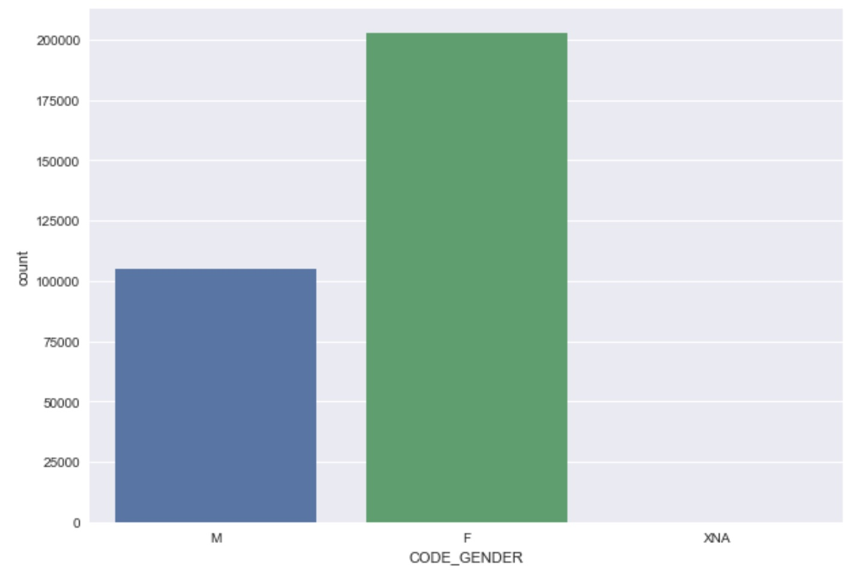
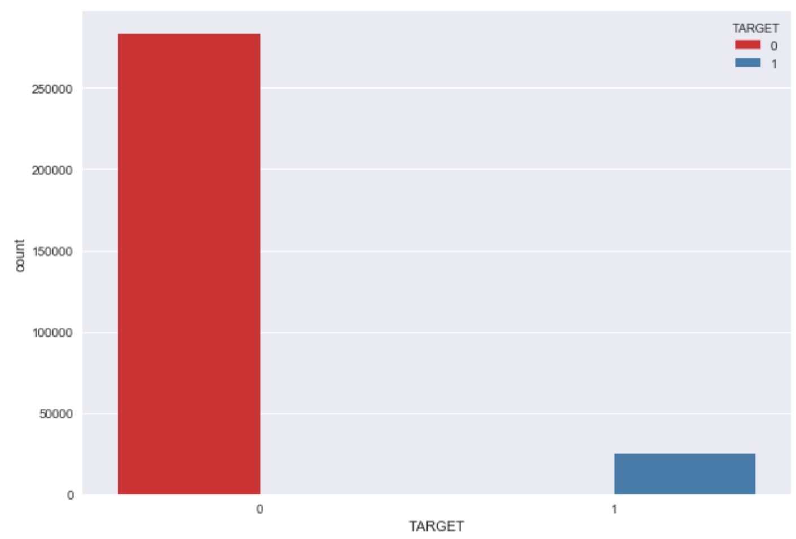
EDA suggests that most people returned the money.
Females are the highest borrowers with counts:
F - 202448
M - 105059
XNA - 4
Most people returned the borrowed money:
0 - 282686
1 - 24825
09

Slide 11
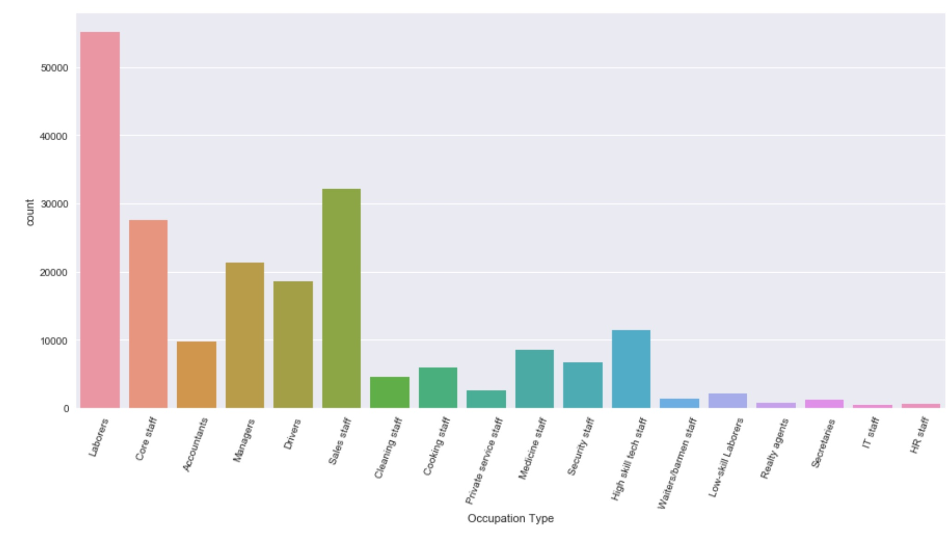
Laborers - occupation type were the most borrowers.
Most of the clients are laborers and the least of the clients are IT Staff.
10
More EDA in Notebook.

Slide 12
Predictive Modeling – Outcome of the model is expected to
identify the potential that someone will default on a loan.
ML Model :
INPUT FEATURES/ COLUMNS
PREDICTED OUTPUT
(After feature engineering)
(classification for 0 or 1)
Expected Target Outcome: 0 or 1, 0 – Not a defaulter, 1 – potential defaulter.
Perfomance Metrics used : Accuracy.
Models currently used : Logistic regression, Random forest, XGBoost, LightGBM, Naïve bayes, Model ensemble.
11

Slide 13
Training and Testing datasets were subjected to the same
feature engineering to evaluate the model.
Randomly sampled 66.66% data
33.33% data
Training set
Testing set
Out of the main training dataset, a certain percentage is kept untrained to test the model’s performance.
Training set and validation set are split in following percentages: 66.66% : 33.33%.
On the testing set, the target labels are hidden, until the performance is evaluated.
12

Slide 14
Currently there are 6 models used.
Model Name | Hyperparameters | Accuracy
LogisticRegression | (C=2, class_weight=None, dual=False, fit_intercept=True, intercept_scaling=1, max_iter=100, multi_class='ovr', n_jobs=1, penalty='l2', random_state=None, solver='liblinear', tol=0.0001, verbose=0, warm_start=False) | 92.01%
RandomForestClassifier | (bootstrap=True, class_weight=None, criterion='gini', max_depth=None, max_features='auto', max_leaf_nodes=None, min_impurity_decrease=0.0, min_impurity_split=None, min_samples_leaf=1, min_samples_split=2, min_weight_fraction_leaf=0.0, n_estimators=500, n_jobs=-1, oob_score=False, random_state=50, verbose=1, warm_start=False) | 91.98%
XGBClassifier | (base_score=0.5, colsample_bylevel=1, colsample_bytree=1, gamma=0, learning_rate=0.1, max_delta_step=0, max_depth=5, min_child_weight=1, missing=None, n_estimators=250, nthread=-1, objective='binary:logistic', reg_alpha=0, reg_lambda=1, scale_pos_weight=1, seed=0, silent=True, subsample=1) | 92.06%
LightGBM | (boosting_type='gbdt', class_weight=None, colsample_bytree=1.0, learning_rate=0.1, max_depth=-1, min_child_samples=20, min_child_weight=0.001, min_split_gain=0.0, n_estimators=100, n_jobs=-1, num_leaves=31, objective=None, random_state=None, reg_alpha=0.0, reg_lambda=0.0, silent=True, subsample=1.0, subsample_for_bin=200000, subsample_freq=0) | 92.04%
NaïveBayesClassifier | (priors=None) | 32.63%
All Stacked | Same as above, but voted. | 92.04%
13
More Explanation in Notebook.

Slide 15
XGBoost is currently the best chosen model, Until further work.
More feature engineering could be done, such as mathematical transformation, possibly: certain columns to log and such.
Advanced techniques like SMOTE could be deployed to handle the class imbalance problems.
DNN’s can be used.
Long short term memory networks could be used to incorporate time series data.
Advanced forms of stacking can be used apart from voting.
Recursive feature selection can be used to reduce the features.
14

Slide 16
Value add to this project.
Performed data wrangling / cleaning, setting up the data for analysis and model building.
Dealt with data having anomalies.
Added Interaction variables.
Performed hyperparameters optimization.
Incorporated Domain Feature engineering.
Performed Exploratory Data Analysis.
Discovered patterns in data.
Built bagging based ensemble model.
15

Slide 17
Questions?
Thank you!
16

